Slide 1
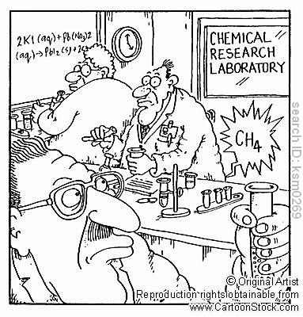
Ionic Reactions

Slide 2

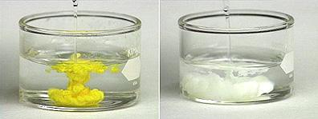
Solubility
=max. amount that dissolve/L of solvent at a specific temperature
solubility > 0.1 mol/L = soluble
solubility < 0.1 mol/L = insoluble (highlight on table on your note)
insoluble = precipitate

Slide 3
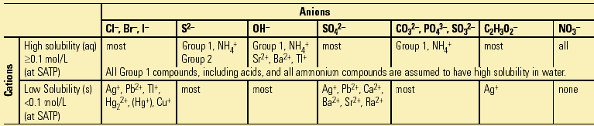
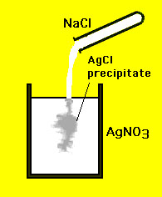
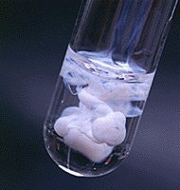
Example
AgNO_{3(aq)} + NaCl_{(aq)}➔
AgCl_{(s)} + NaNO_{3(aq)}

Slide 4
Each person in group choose a different one of these reactions and write on your sheet.
Option 1:
Mg(NO₃)₂ _{(aq)} + Na₂CO₃ _{(aq)} → MgCO_{3 (s)} + 2 NaNO_{3 (aq)}
Option 2:
2 Cr(NO₃)_{3 (aq)} + 3 FeSO_{4 (aq)} → 3 Fe(NO₃)_{2 (aq)} + Cr₂(SO₄)_{3 (aq)}
Option 3:
K₃PO_{4 (aq)} + Al(NO₃)_{3 (aq)} → AlPO_{4 (s)} + 3 KNO₃ _{(aq)}
Option 4:
BeI_{2 (aq)} + Cu₂SO_{4 (aq)} → BeSO_{4 (aq)} + 2 CuI _{(s)}

Slide 5
STEP 1
Review the next 3 slides, then complete for your reaction.
Check each other’s work in your group.

Slide 6
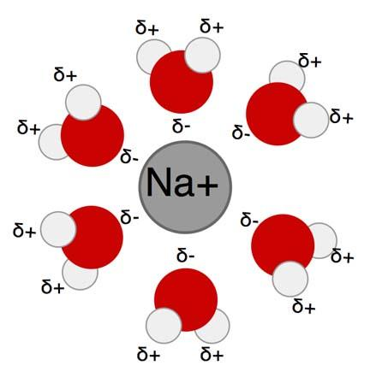
Ionic Reactions
to create an ionic equation, specify individual ions present
e.g. dissolve NaCl_{(s)} in water, it becomes:
Na⁺_{(aq)} + Cl⁻_{(aq)}

Slide 7

Ionic Reactions
e.g. # 2 sodium hydroxide + hydrochloric acid:
NaOH_{(aq)} + HCl_{(aq)} ➔ NaCl_{(aq)} + H₂O_{(l)}
now identify ions (only aq!):
Na⁺_{(aq)} + OH⁻_{(aq)} + H⁺_{(aq)} + Cl⁻_{(aq)} ➔ Na⁺_{(aq)} + Cl⁻_{(aq)} + H₂O_{(l)}

Slide 8
COUNT ALL IONS AND USE COEFFICENTS ONLY TO INDICATE NUMBER
examples:
2NaCl _{(aq)} becomes 2Na ⁺_{(aq)} + 2 Cl__{(aq)}
MgCl₂ _{(aq)} becomes Mg ²⁺_{(aq)} + 2 Cl__{(aq)}
What would 2MgCl₂ become?
WHY does AgCl NOT separate into ions?
Complete this separation to ions for ALL compounds in your reaction THAT ARE AQUEOUS and compare with group.

Slide 9
STEP 2
Review the next 3 slides then complete for your reaction.
Check each other’s work in your group

Slide 10

Net Ionic Rxns
now cancel ions appearing on both sides of the ionic equation
called spectator ions
as they are not really involved in reaction
They begin the reaction
as dissolved ions and
are still the same
dissolved ion after

Slide 11

Net Ionic Rxns
for our example:
Na⁺_{(aq)} + OH⁻_{(aq)} + H⁺_{(aq)} + Cl⁻_{(aq)} ➔ Na⁺_{(aq)} + Cl⁻_{(aq)} + H₂O_{(l)}
OH⁻_{(aq)} + H⁺_{(aq)} ➔ H₂O_{(l)}
or base + acid ➔ water
note that only (aq) species become ions and may become spectator ions

Slide 12
NOTE:
Coefficients AND charges AND states must all be identical to fully cancel out.
Complete Step 2 and compare in your groups

Slide 13
STEP 3
Just rewrite what remains (everything NOT crossed out on either side). See next slide for example.
Compare with your group and with other groups.

Slide 14
Net Ionic Rxns
consider the original example
AgNO_{3(aq)} + NaCl_{(aq)}➔AgCl_{(s)} + NaNO_{3(aq)}
total ionic:
Ag⁺_{(aq)} + NO₃⁻_{(aq)} + Na⁺_{(aq)} + Cl⁻_{(aq)} ➔ AgCl_{(s)} + Na⁺_{(aq)} + NO₃⁻_{(aq)}
net ionic:
Ag⁺_{(aq)} + Cl⁻_{(aq)} ➔ AgCl_{(s)}

Slide 15
Now lets try this one:
Ni(NO3)3 (aq) + 3 KBr (aq) NiBr3 (aq) + 3 KNO3 (aq)

Slide 16



Rxn Drive
net ionic equation also reflects one reason the reaction moved forward

